Slide 1



Characterizing the Atmospheres of Low Surface Gravity M-dwarfs
Isabela Huckabee
Mentors: Aishwarya Iyer and Michael Line
Arizona State University
2021 Arizona NASA Space Grant Consortium Syposium
4/17/2021

Slide 2
Why Study Low Gravity M-dwarfs?
M-dwarf stars are most probable host for finding exoplanets
M-dwarf atmospheres dominated by molecules
→ Why do low gravity M-dwarfs appear brighter in the infrared than typical M-dwarfs (Faherty et al., 2016)?

Slide 3
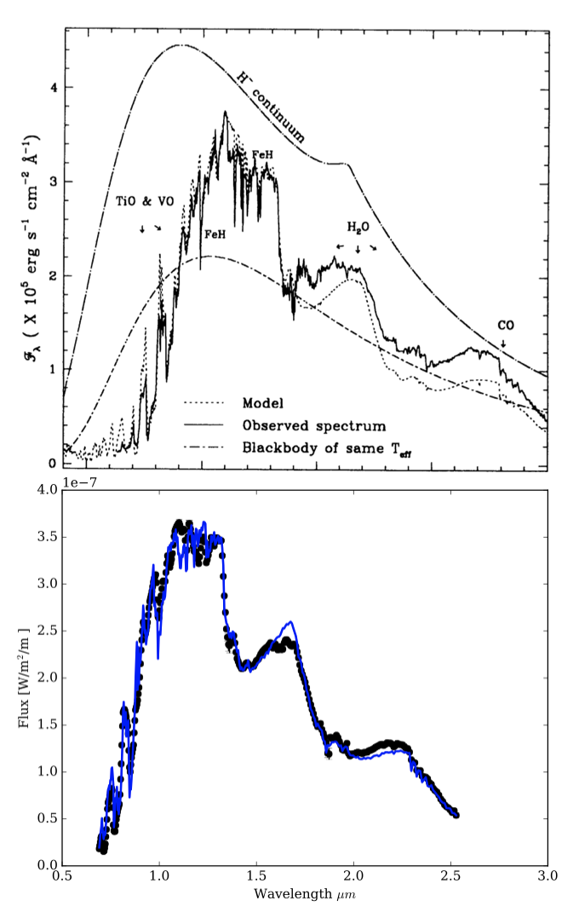
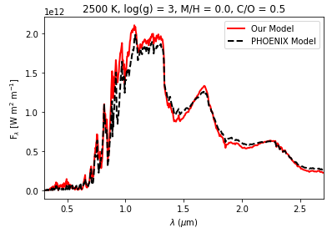
Improved overall base model: added opacities (reaction rates)
Previous model
Extended capabilities down to low surface gravities
Our model
Low gravity models
(Iyer et al., in prep)

Slide 4
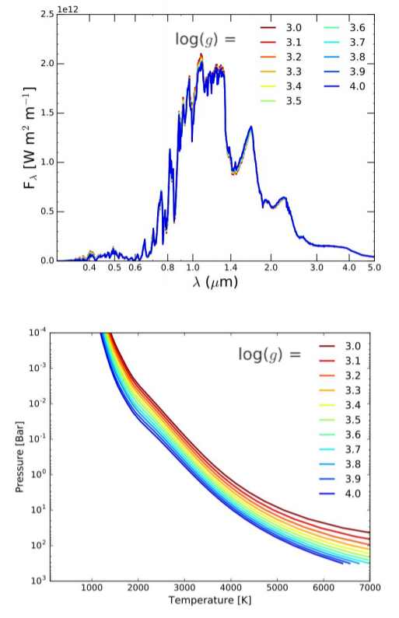
Little change in spectra
Lower gravity = “hotter” internally
High gravity → Low gravity
Low temp → High temp

Slide 5
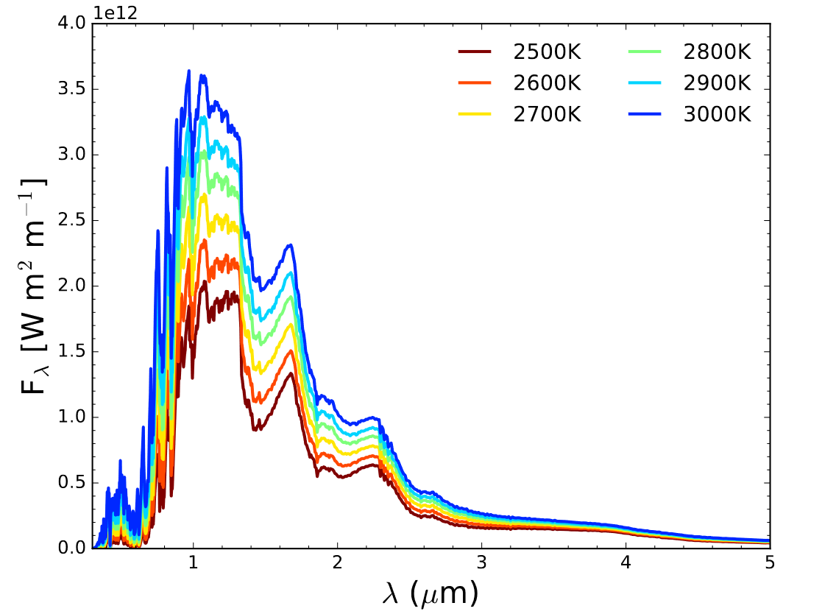
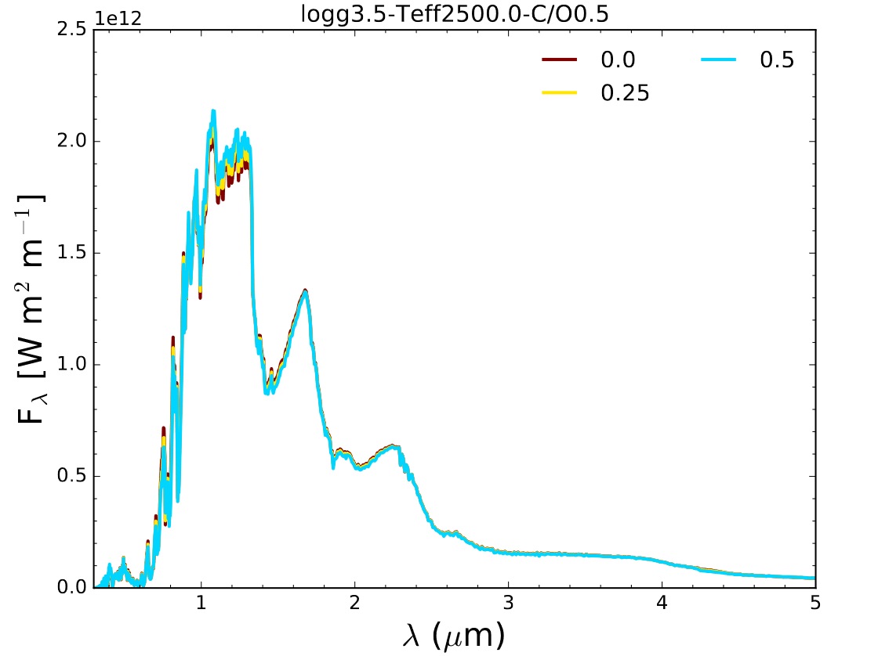
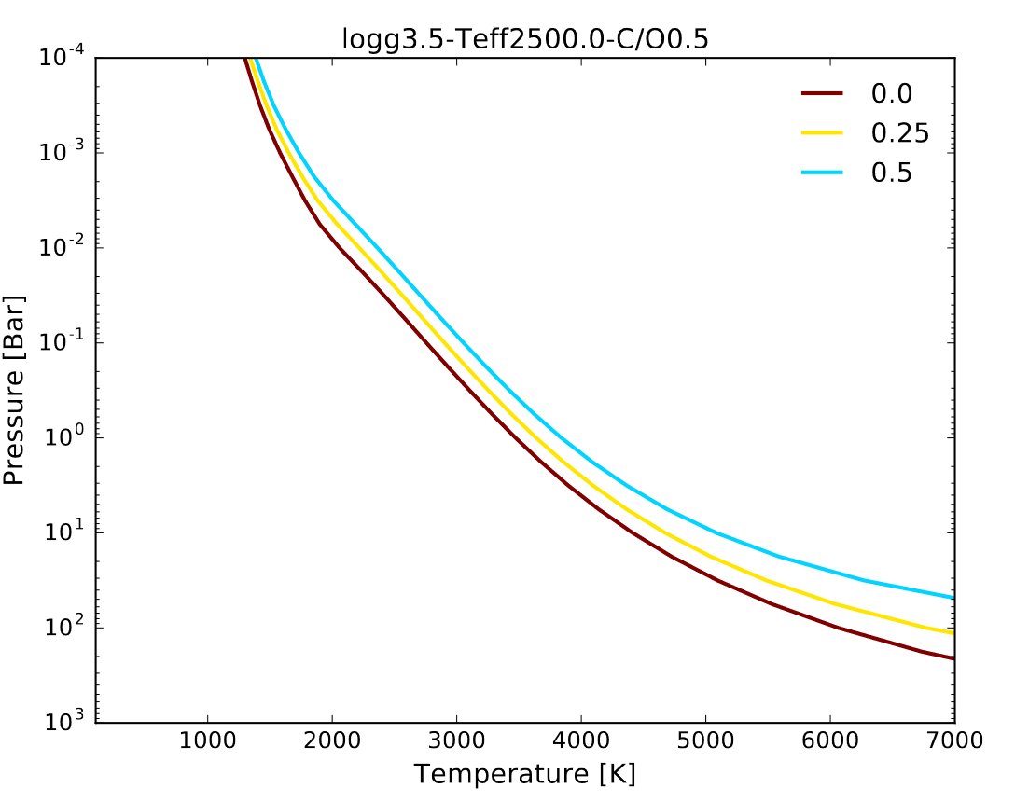
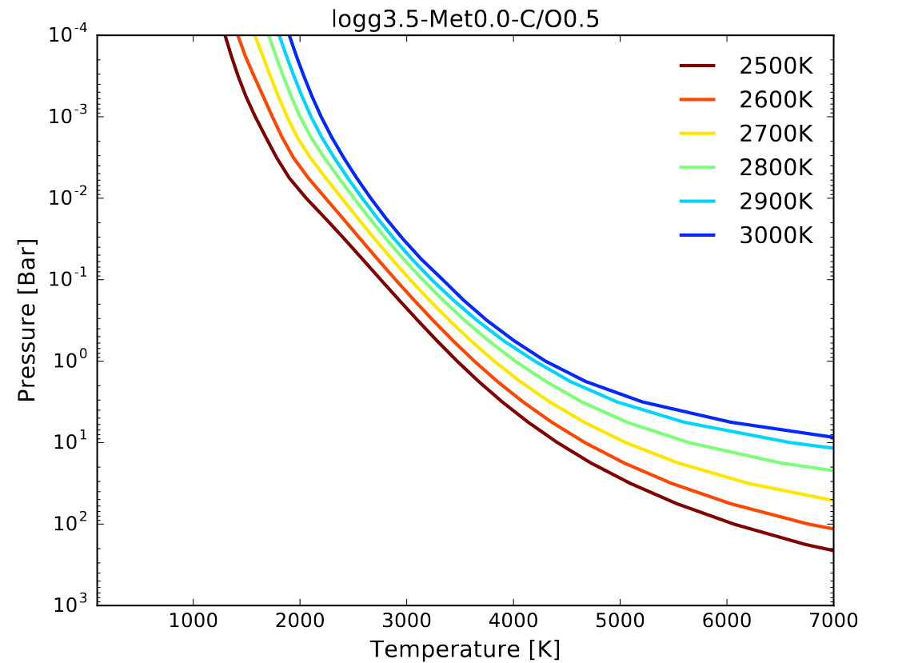
Low-gravity minigrid slices
Varying Teff (left)
Varying metallicity (right)

Slide 6
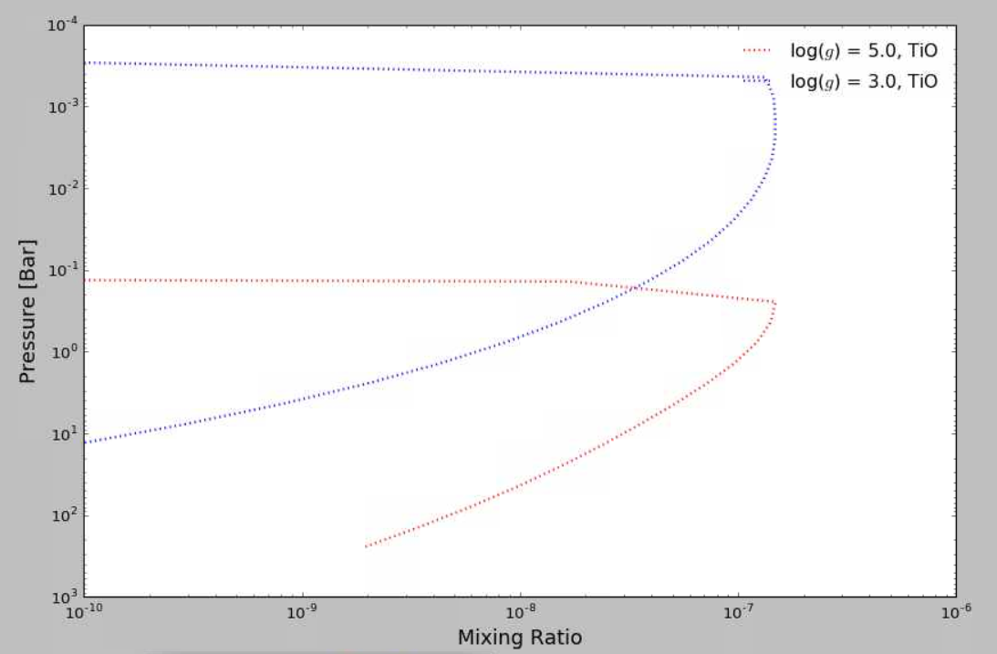
Vertical Mixing Ratios → How much stuff is in the atmosphere?
TiO appears at higher altitudes in lower gravity

Slide 7
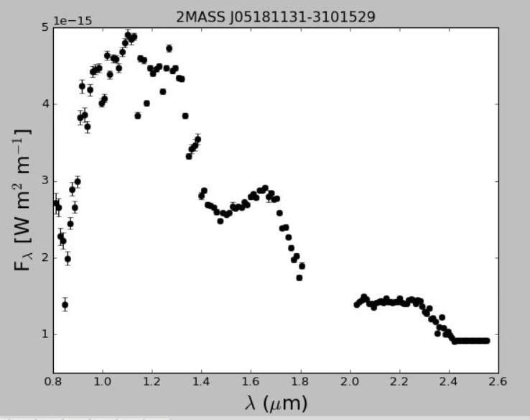
Future Work
Start fits with low gravity targets (in progress)
Simplified or cloud-free models are not enough to reproduce observations
  Adding a cloud/dust layer to base M-dwarf model code

Slide 8
Thank you!

